Slide 1




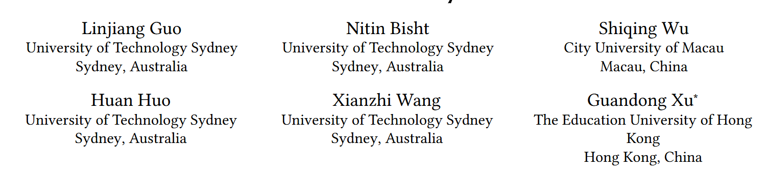




ATAI
Advanced Technique of Artificial Intelligence
ATAI
ChongqingUniversity _{AdvancedTechniqueof}
of Technology Artificial Intelligence
Chongqing University of
Technology
Chongqing University ^{ATAI}
_{of Technology} Advanced Techniqueof
Artificial Intelligence
Chongqing University of Technology
Chongqing University of Technology
Diagnosing and Mitigating Mid-Sequence Degradation in Recommender Systems
——SIGIR '26
Reported by Meihong Li
1

Slide 2
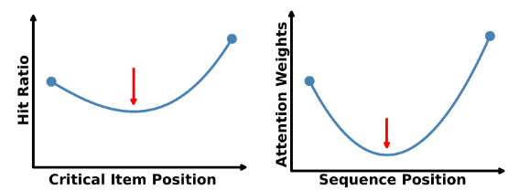
ATAI
Advanced Technique of Artificial Intelligence
ATAI
ChongqingUniversity _{AdvancedTechniqueof}
of Technology Artificial Intelligence
Chongqing University of
Technology
Chongqing University ^{ATAI}
_{of Technology} Advanced Techniqueof
Artificial Intelligence
Chongqing University of Technology
Chongqing University of Technology
Motivation
1. Attention disproportionately concentrates on sequence boundaries, suppressing informative mid-sequence behaviors.
2. Mitigating this bias is non-trivial because:
i) Bias–Signal Entanglement: Positional bias is entangled with collaborative signals and sequential dependencies.
ii) Data Discrepancy: dense semantic tokens in LLMs VS sparse item IDs with strict chronological dependencies.
iii) Temporal Causality: Debiasing should preserve the chronological structure of user behavior sequences.
Notes:
同质图：节点都是一种类型，例如“用户”。边也是一种类型， “交互”。U-I图其实就是异构图

Slide 3
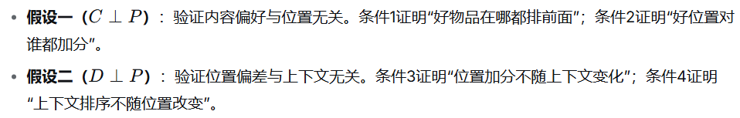
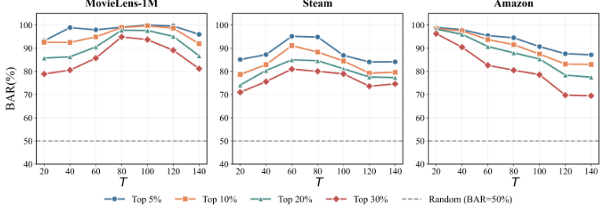
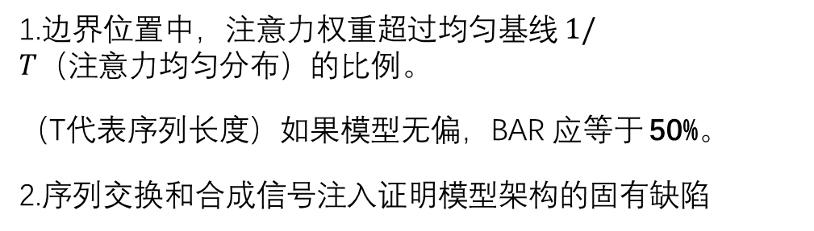
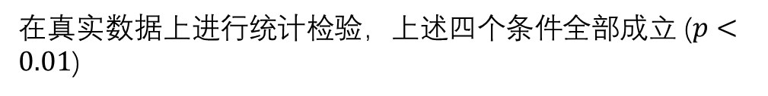
ATAI
Advanced Technique of Artificial Intelligence
ATAI
ChongqingUniversity _{AdvancedTechniqueof}
of Technology Artificial Intelligence
Chongqing University of
Technology
Chongqing University ^{ATAI}
_{of Technology} Advanced Techniqueof
Artificial Intelligence
Chongqing University of Technology
Chongqing University of Technology
Method
一、U型偏差的量化 (BAR)
二、注意力可分解性的证明 (反证法)
1.边界位置中，注意力权重超过均匀基线 $1/T（注意力均匀分布）$的比例。
（T代表序列长度）如果模型无偏，BAR 应等于 50%。
2.序列交换和合成信号注入证明模型架构的固有缺陷
在真实数据上进行统计检验，上述四个条件全部成立 ($p<0.01$)

Slide 4
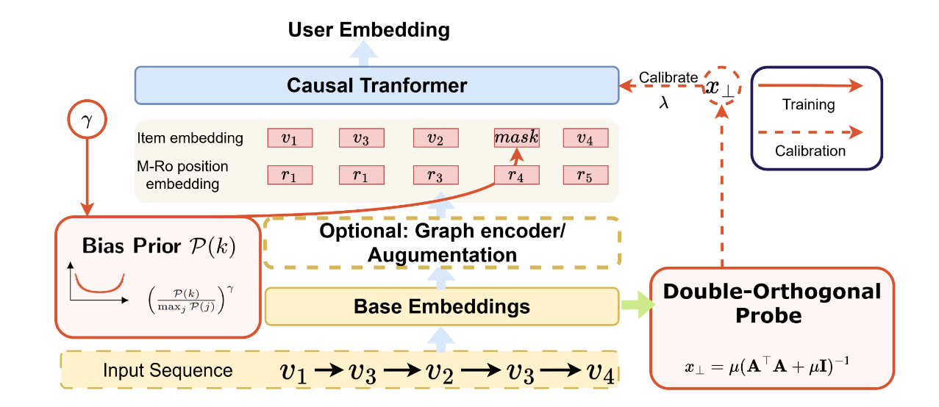
ATAI
Advanced Technique of Artificial Intelligence
ATAI
ChongqingUniversity _{AdvancedTechniqueof}
of Technology Artificial Intelligence
Chongqing University of
Technology
Chongqing University ^{ATAI}
_{of Technology} Advanced Techniqueof
Artificial Intelligence
Chongqing University of Technology
Chongqing University of Technology
Method

Slide 5
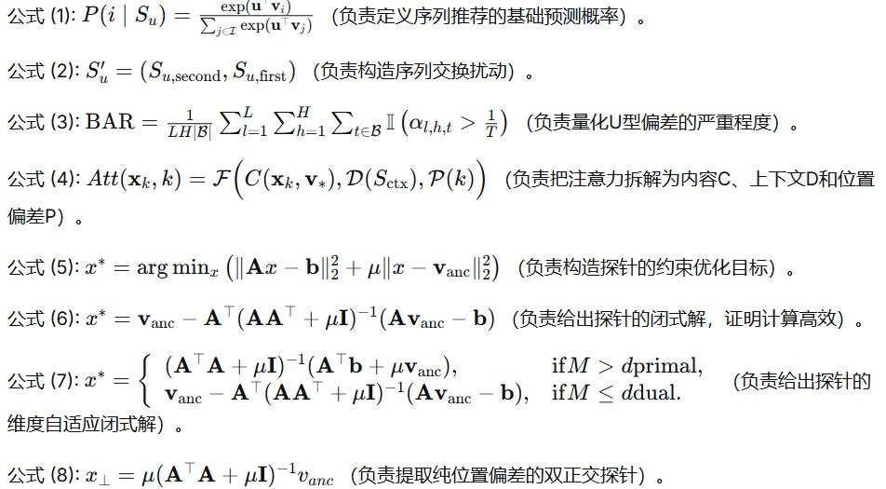
ATAI
Advanced Technique of Artificial Intelligence
ATAI
ChongqingUniversity _{AdvancedTechniqueof}
of Technology Artificial Intelligence
Chongqing University of
Technology
Chongqing University ^{ATAI}
_{of Technology} Advanced Techniqueof
Artificial Intelligence
Chongqing University of Technology
Chongqing University of Technology
Method

Slide 6
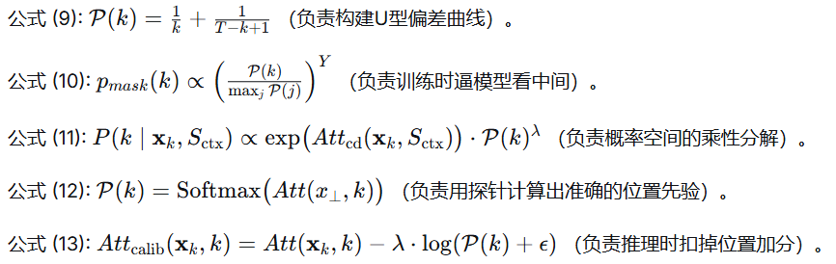
ATAI
Advanced Technique of Artificial Intelligence
ATAI
ChongqingUniversity _{AdvancedTechniqueof}
of Technology Artificial Intelligence
Chongqing University of
Technology
Chongqing University ^{ATAI}
_{of Technology} Advanced Techniqueof
Artificial Intelligence
Chongqing University of Technology
Chongqing University of Technology
Method

Slide 7

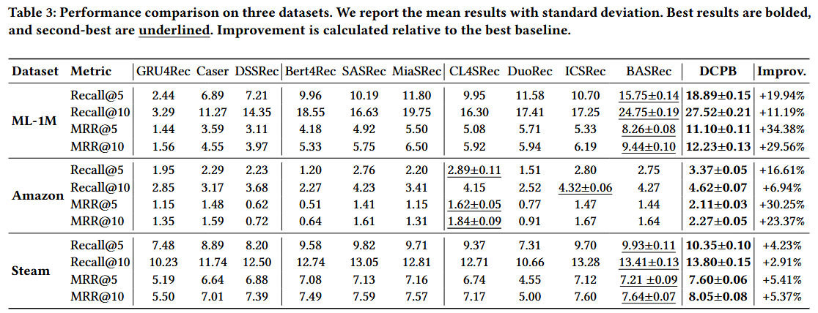
ATAI
Advanced Technique of Artificial Intelligence
ATAI
ChongqingUniversity _{AdvancedTechniqueof}
of Technology Artificial Intelligence
Chongqing University of
Technology
Chongqing University ^{ATAI}
_{of Technology} Advanced Techniqueof
Artificial Intelligence
Chongqing University of Technology
Chongqing University of Technology

Slide 8
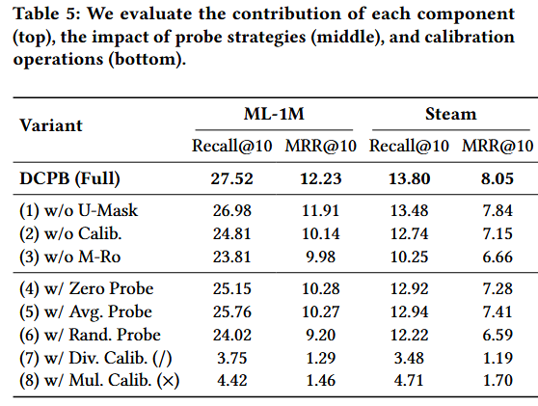
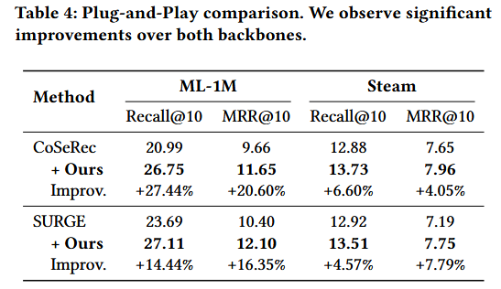
ATAI
Advanced Technique of Artificial Intelligence
ATAI
ChongqingUniversity _{AdvancedTechniqueof}
of Technology Artificial Intelligence
Chongqing University of
Technology
Chongqing University ^{ATAI}
_{of Technology} Advanced Techniqueof
Artificial Intelligence
Chongqing University of Technology
Chongqing University of Technology

Slide 9
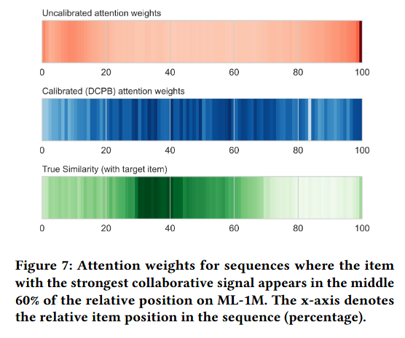
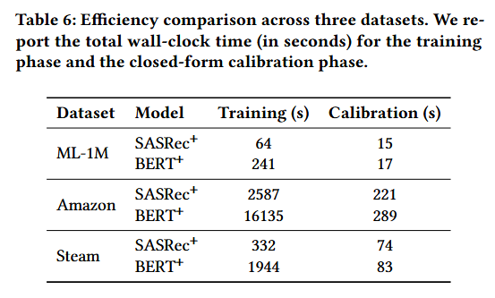
ATAI
Advanced Technique of Artificial Intelligence
ATAI
ChongqingUniversity _{AdvancedTechniqueof}
of Technology Artificial Intelligence
Chongqing University of
Technology
Chongqing University ^{ATAI}
_{of Technology} Advanced Techniqueof
Artificial Intelligence
Chongqing University of Technology
Chongqing University of Technology

Slide 10


ATAI
Advanced Technique of Artificial Intelligence
ATAI
ChongqingUniversity _{AdvancedTechniqueof}
of Technology Artificial Intelligence
Chongqing University of
Technology
Chongqing University ^{ATAI}
_{of Technology} Advanced Techniqueof
Artificial Intelligence
Chongqing University of Technology
Chongqing University of Technology
Thanks!

